Slide 1


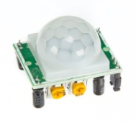

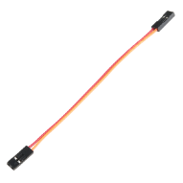
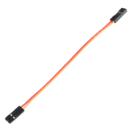


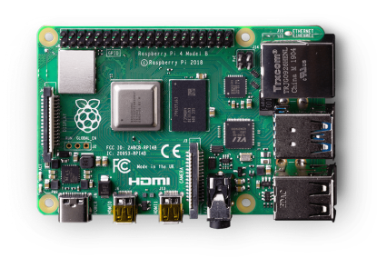
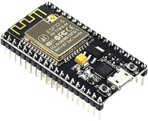
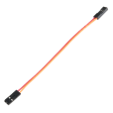

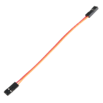



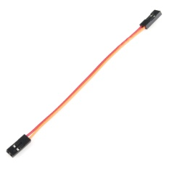
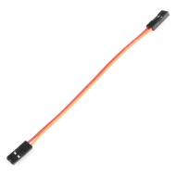
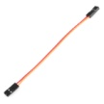
Node MCU
MegaPhone
Raspberry Pi
PIR sensors
Wireless Communication
Wild boars
Iridium Lighting

Slide 2
SPECIFICATIONS

Slide 3
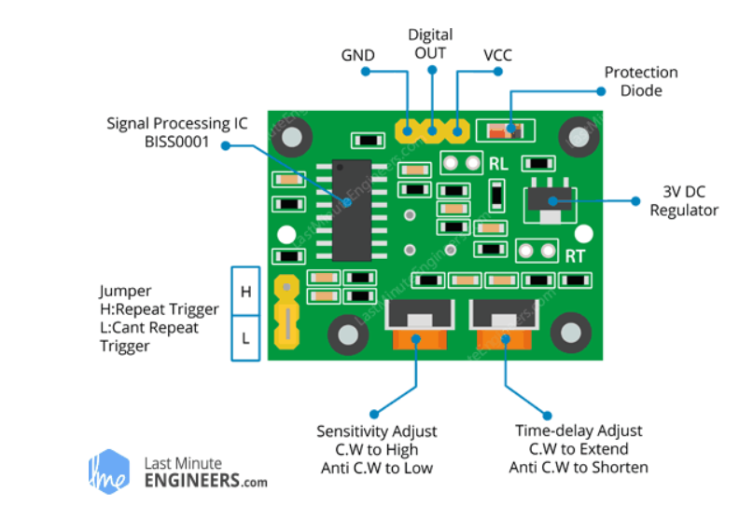
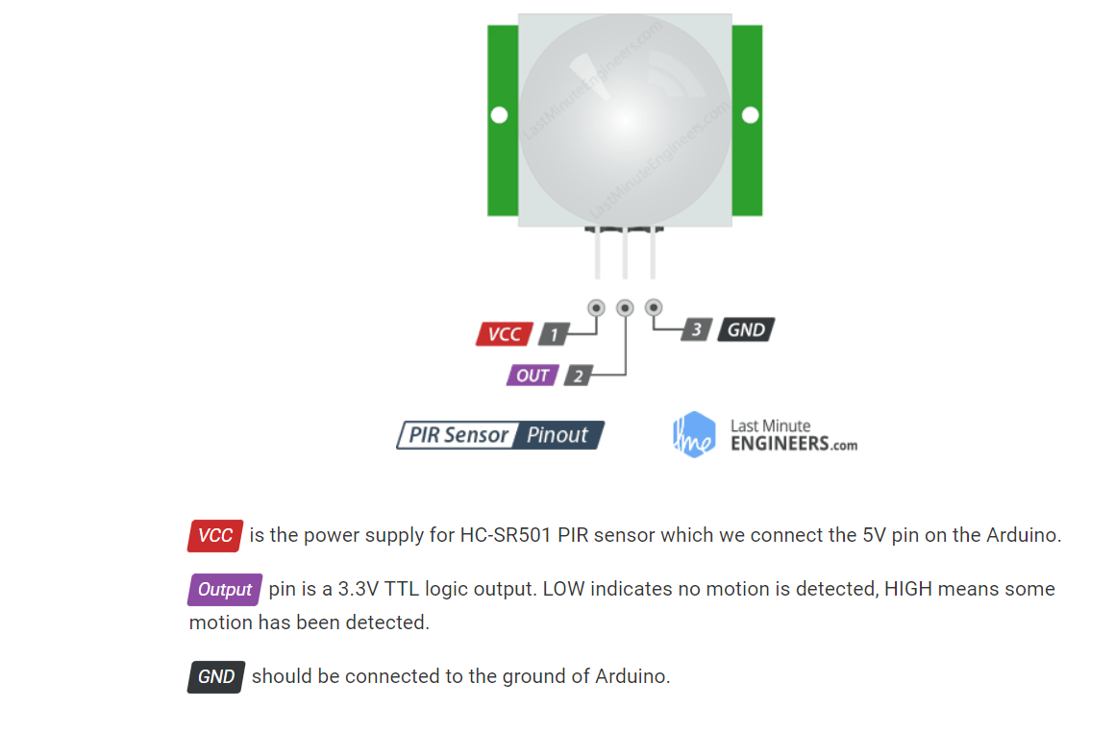
Specifications |PIR Sensor (HC-SR501)
Module specs
Power Requirement

Slide 4
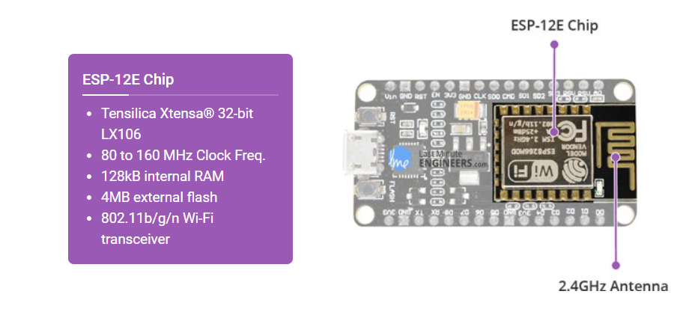
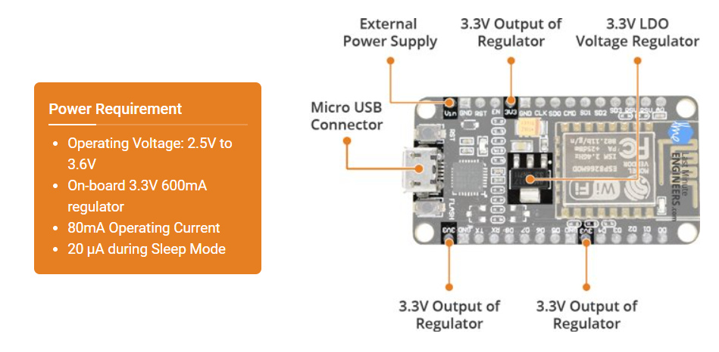
Specifications | ESP8266 Node MCU
Module specs
Power Requirement

Slide 5
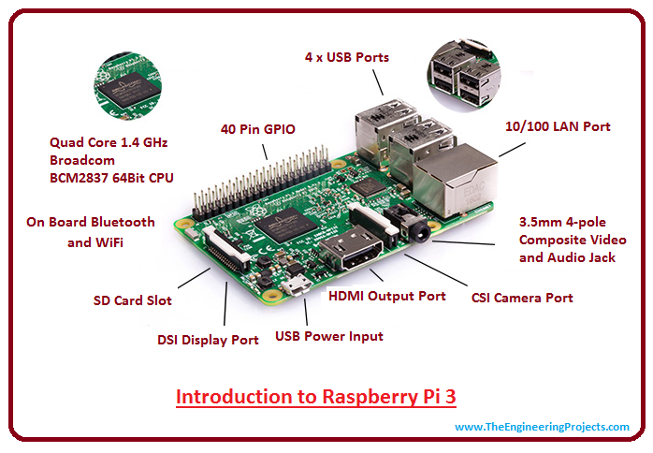
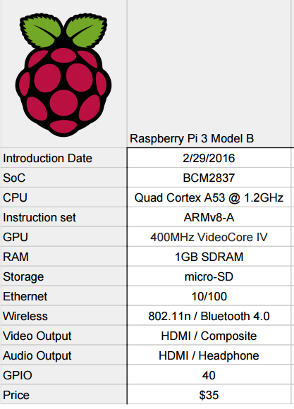
Specifications |Raspberry pi
Module specs
Power Requirement

Slide 6
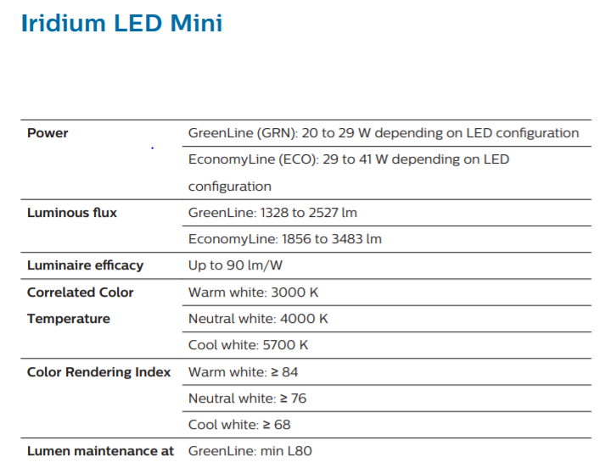
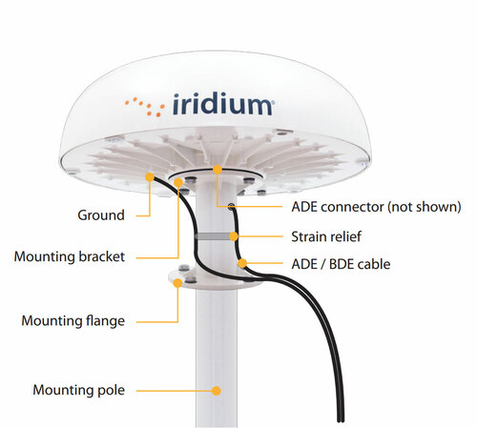
Specifications |Iridium Light
Module specs
Power Requirement

Slide 7
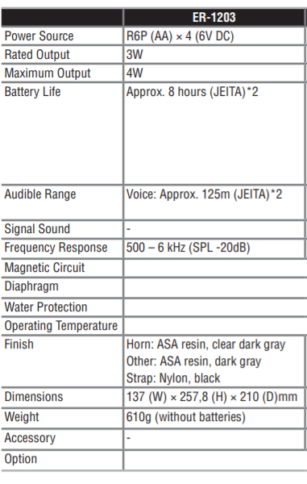

Specifications |Iridium Light
Module specs
Power Requirement

Slide 8
Working

Slide 9
Step 1: The PIR sensors are allocated at the perimeters of the field according to the radius of the sensor.
Step 2: When a Wild boar enters into the range of a Pir Sensor, Even if One pir sensor reads the movement.. The trigger is raised.
Step 3: As soon as the trigger is raised.. It is sent over to the multi media processor via wireless communicaiton.. with the help of an Esp 32 wifi module ( Node MCU)..
Step 4: When the multimedia processor ( Raspberry pi ) Recieves the information that something approached the premises.. It immediately plays a collection of randomized audio files. along with an Iridium lighting to scare the Animal Away.

